Slide 1
Clinical Microbiology by Dr. Hussein ALNaji

Slide 2
Mannitol Salt Agar (MSA):
Mannitol salt agar is both a selective and differential media used for the isolation of pathogenic Staphylococci from mixed cultures.
On MSA, only pathogenic Staphylococcus aureus produces small colonies surrounded by yellow zones. The reason for this color change is that S. aureus have the ability to ferment the mannitol, producing an acid, which, in turn, changes the indicator color from red to yellow.
This growth differentiates S.aureus from S.epidermidis, which forms colonies with red zones or both zones.

Slide 3
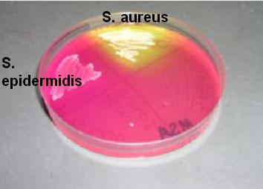

Slide 4
MacConkey’s Agar (MAC):
MacConkey’s Agar is both a selective and differential media; it is selective for Gram negative bacteria and can differentiate those bacteria that have the ability to ferment lactose.
By utilizing the available lactose in the medium, Lac+ (Lactose positive) bacteria such as Escherichia coli, Enterobacter and Klebsiella will produce acid in the medium, results in the appearance of red or pink colonies.
Non-lactose fermenting bacteria such as, Proteus species,Salmonella, Pseudomonas aeruginosa and Shigella cannot utilize lactose in the medium, and will use peptone instead. and leads to the formation of white or colorless colonies in the plate.

Slide 5
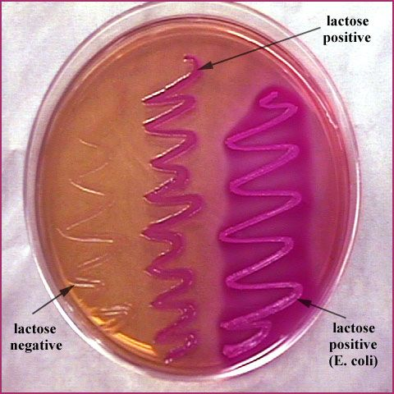

Slide 6
Eosin Methylene Blue (EMB) Agar (Levine):
It is both a selective and differential medium used for the detection and isolation of Gram- intestinal pathogens.
Acid production from lactose fermentation causes precipitation of the dyes on the surface of the colony resulting in different colors.
Large amounts of acid → green metallic sheen
Small amounts of acid → pink
No fermentation → colorless
Enterobacter aerogenes produces large colonies which are pink-to-buff around dark centers. Escherichia coli produce small, dark colonies with a green metallic sheen. Pseudomonas, Proteus, Salmonella and Shigella sp produces colorless colonies because it does not ferment lactose.

Slide 7
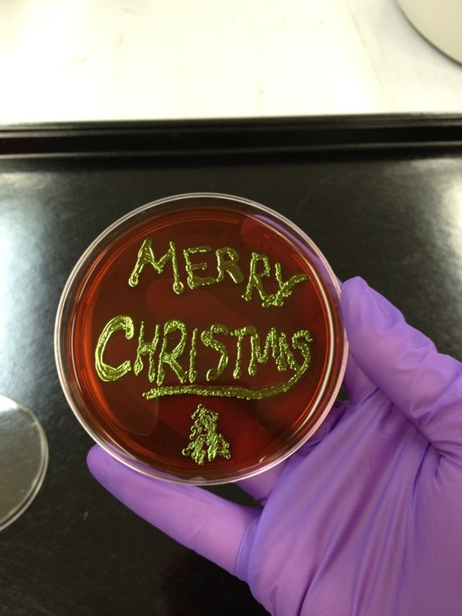
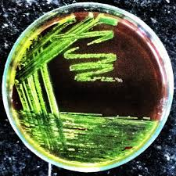
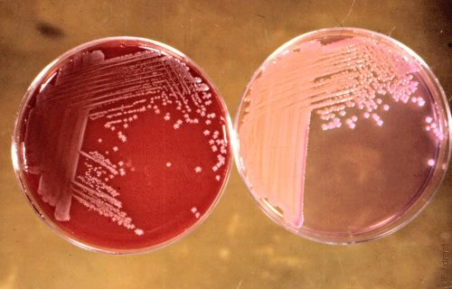

Slide 8
Salmonella Shigella Agar (SS Agar).
It is a selective and differential medium widely used in sanitary bacteriology to isolate Salmonella and Shigella from feces, urine, and fresh and canned foods. Inhibition of gram-positive microorganisms is obtained by the bile salts mixture.
Lactose fermenter: If lactose fermentation occurs, the medium will turn red due to the acidic pH. E.g. Escherichia coli, Klebsiella pneumoniae gives red colonies.
Non-Lactose fermenter: Salmonella, Shigella,and other non-lactose fermenters appear as transparent or translucent colorless colonies. Colonies of Salmonella spp. may appear with or without black centers (depending on the species isolated).

Slide 9
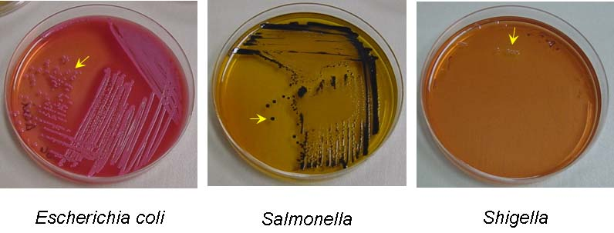

Slide 10
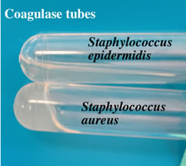
Biochemical reactions:
microbiology laboratories typically will identify a pathogen in a clinical sample, purify the microorganism by plating a single colony of the microorganism on a separate plate, and then perform a series of biochemical studies that will identify the bacterial species.
Coagulase test
used to distinguish between Staphylococcus aureus from coagulase negative Staphylococcus spp.

Slide 11
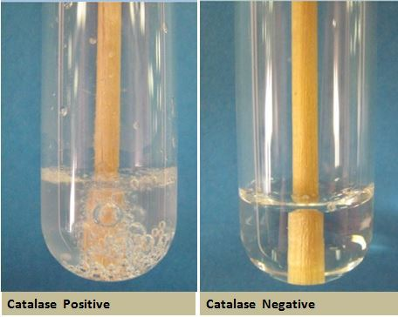
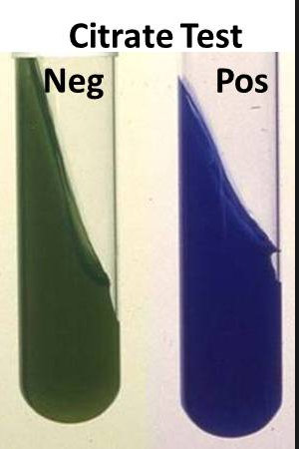
Catalase test
The catalse test is primarily used for gram positive bacteria and can for instance be utilized to distinguish Staphylococcus spp. and Micrococcus spp., which are catalase positive from Streptococcus spp. and Enterococcus spp.
Citrate test
used to distinguish between, among others Citrobacter freundii and Escherichia coli.

Slide 12
Indole test
Confirmation of suspected E. coli-strains.
Oxidase test
The oxidase test is used for identification of gram negative bacteria.
Urease test
The urease test can be used to distinguish between E. coli, which is urease negative, from Proteus spp., which are urease positive.
Voges-Proskauer (VP) test
Klebsiella spp. and Enterobacter spp. has the capacity to perform butanediole fermentation in contrast to Escherichia coli, Salmonella spp. and Shigella spp.

Slide 13
